Slide 1
Web Crawler for jobs
Prof.: Yen-Wen Chen
Student: Ke-Chin Lee
2020/7/14

Slide 2
Outline
Introduction
Process
Result

Slide 3
Introduction
Web crawler is a program that can automatically crawl web content.
This implementation case is to crawl the job list of 104.com and working experience of goodjob.life. However, I design a simple webpage to show the total job vacancies.

Slide 4
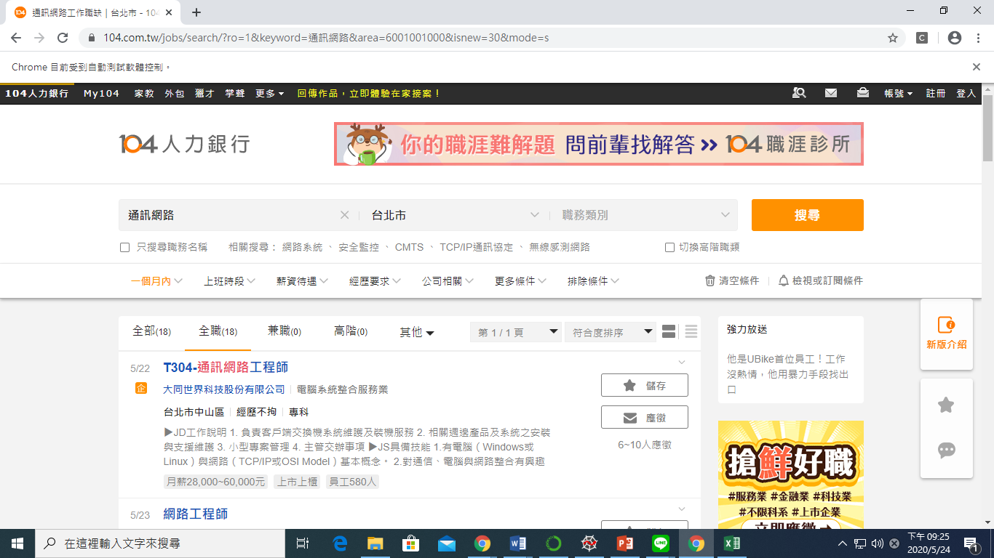
Introduction

Slide 5
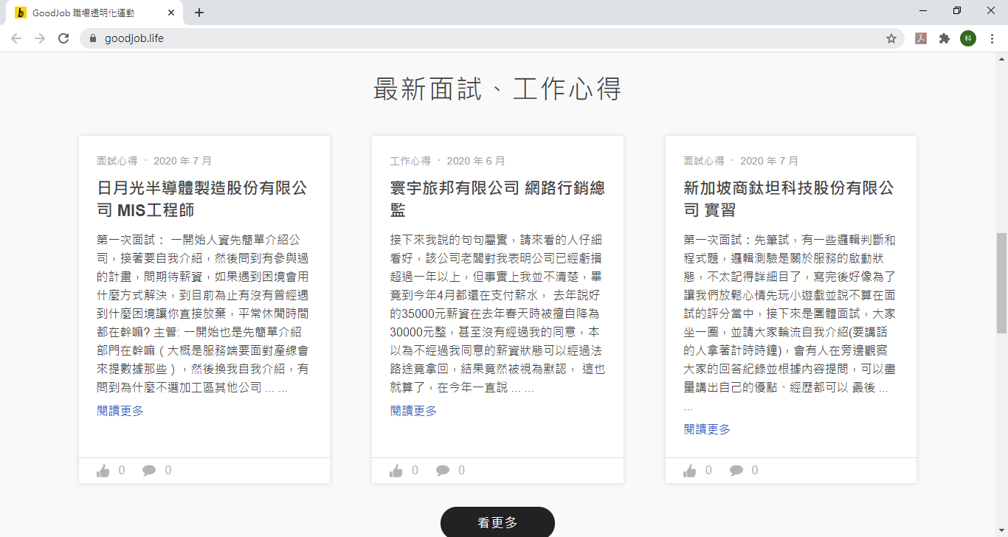
Introduction

Slide 6
Process

Slide 7
Step. 1: generate a sequence of URL lists and send http request.
Step. 2: automatically turn pages with selenium suite.
Step. 3: crawl the 104 job vacancies with BeautifulSoup suite.
Step. 4: crawl the working experience of goodjob.life.
Step. 5: save the required information to json.
Step. 6: display the job vacancies on the web.

Slide 8
The required information is saved as dictionaries and the dictionaries are saved as json.

Slide 9
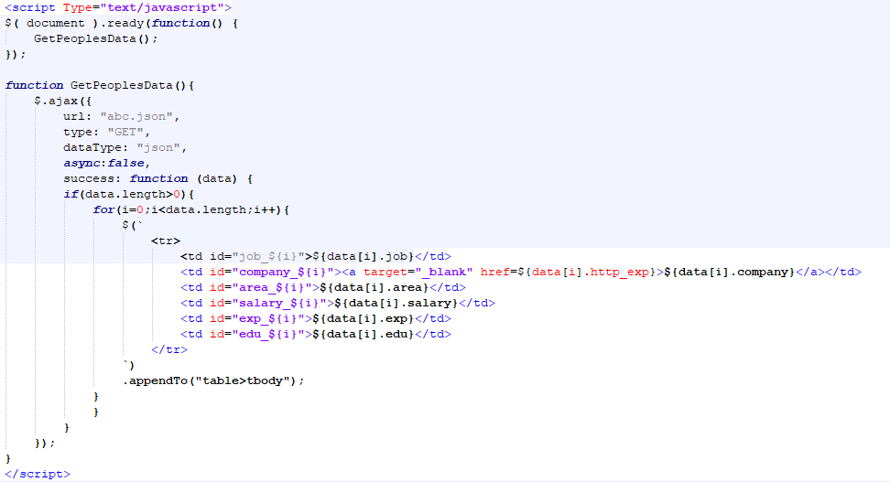
Using jquery to read json information and display it on the webpage.

Slide 10
Web design:
Html: using html tags to design web page architecture.
Css: responsible for beautifying the structure.
Javascript: using jquery to read json information.

Slide 11
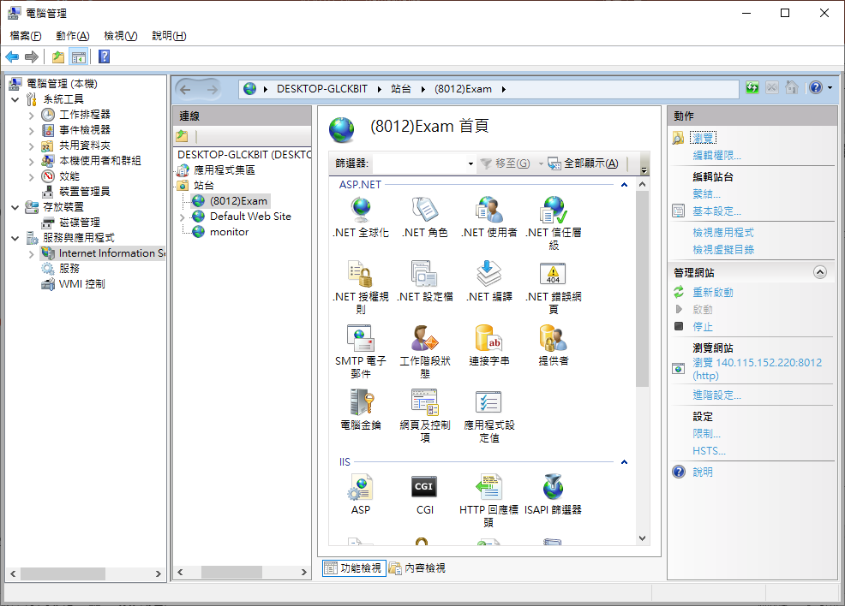
Using the built-in IIS(Internet Information Services) in Windows to set up a web server.

Slide 12
Result

Slide 13
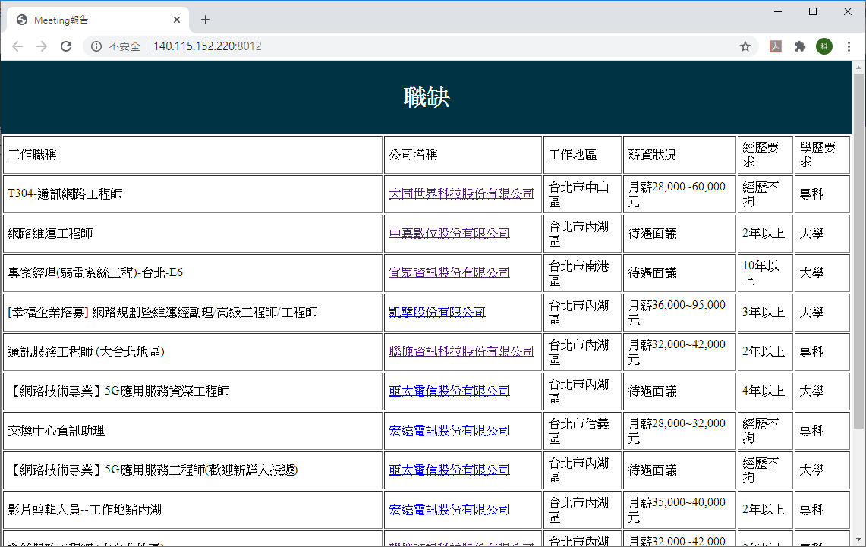
Result

